Slide 1

یادگیری عمیق با تنسورفلو و کراس در پایتون
فصل دوم: معرفی شبکه های عصبی مصنوعی با Keras
پژمان اقبالی
PhD Student in Biomechanics

Slide 2
1943
1960
1980
1990
start
Computationally Expensive
New Architectures
Powerfull Computational Resources
SVM
Huge Data
Computing Power
Training Algorithms
Resolved limitations
Money

Slide 3

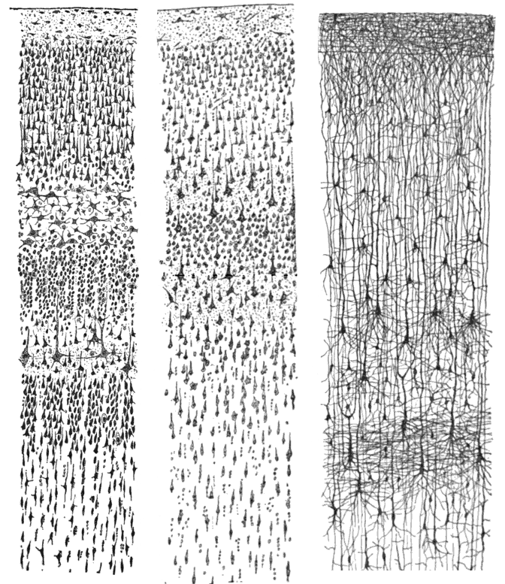
نورون (Neuron)
https://en.wikipedia.org/wiki/Neuron
https://en.wikipedia.org/wiki/Cerebral_cortex

Slide 4




نورون (Neuron)
“A logical calculus of the ideas immanent in nervous activity”
Warren S. McCulloch and Walter Pits

Slide 5
پرسپترون (Perceptron)
“The perceptron: A probabilistic model for information storage and organization in the brain”
Frank Rosenblatt
“The Organization of Behavior” (Wiley)
Donald Hebb
“Perceptrons”
Marvin Minsky and Seymour Papert

Slide 6












Slide 10






Slide 11





Slide 12



Slide 13








































Slide 15
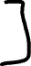
The Multilayer Perceptron and Backpropagation
“Learning Internal Representations by Error Propagation”
David Rumelhart, Geoffrey Hinton, Ronald Williams

Slide 16






















Slide 17













Slide 18

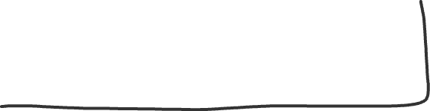








Slide 19









Slide 20



Slide 21




Slide 22







Slide 23





Slide 24
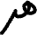




رگرسیون(Regression MLPs)

Slide 25
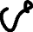
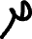

طبقه بندی(Classification MLPs)

Slide 26
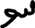













Slide 28










Slide 29





Slide 30
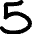


Slide 32
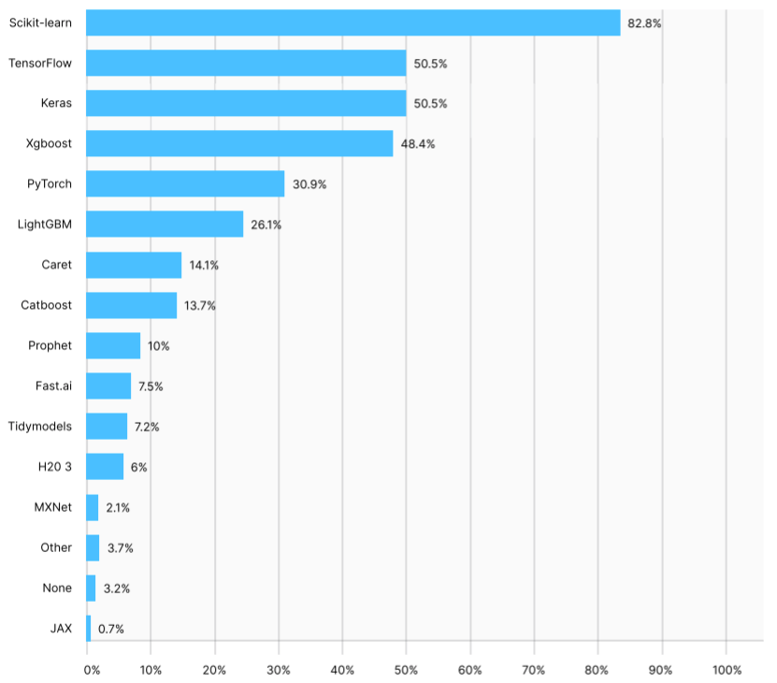
فریمورک های یادگیری ماشین
https://www.kaggle.com/kaggle-survey-2020

Slide 33
Keras
https://keras.io/

Slide 34
Wide and Deep Network
“Wide and Deep Learning for Recommender Systems” Heng-Tze Cheng et al.
Output
Concatenate
Hidden
Hidden
Input

Slide 35
Wide and Deep Network
Output
Concatenate
Hidden
Hidden
InputB
InputA

Slide 36
Wide and Deep Network
Output
Helper Output
Concatenate
Hidden
Hidden
InputB
InputA

Slide 37
Number of hidden layers
Number of neurons per hidden layer
Learning rate
Optimizer
Batch size
Activation function
A disciplined approach to neural network hyperparameters
L. N. Smith 2018
arXiv 1803.09820

